Slide 1
24
7
30
Date
Volume and Capacity of Pyramids and Cones
EQ – How do we find the volume and then the capacity of a pyramid or cone?
5
Notes:
Input

Slide 2

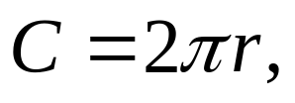
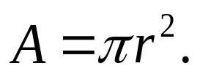
Let’s revise what we already know about circles.
Circumference and Area of a Circle
r
d
The circumference C of a circle of diameter d is given by the formula:
or
where r is a radius.
The area A of a circle with radius r is given by the formula:

Slide 3
Find the area and circumference of a circle with a radius that is 6 inches long (use 3.14 as an approximation for π).
Circumference (π ≈ 3.14)
Circumference (π)
C = 2 π r
C = 2 π r
C = 2 (3.14) 6
C = 2 π 6
C = 37.68 in
C = 37.699 in
Area (π ≈ 3.14)
Area (π)
A = π r²
A = π r²
A = (3.14) 6²
A = π 6²
A = 113.04 in²
A = 113.097 in²

Slide 4
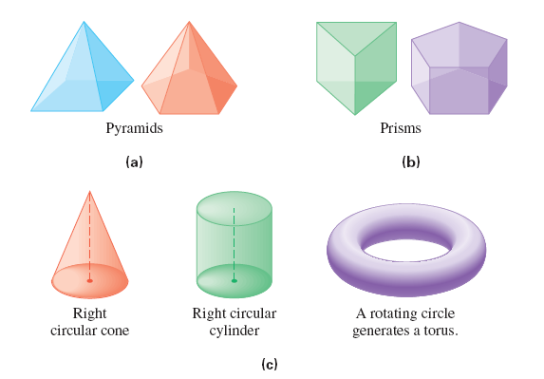
Pyramids are made of triangular sides and a polygonal base.
Prisms have two faces in parallel planes; these faces are congruent polygons.

Slide 5
Right Circular Cones have a circle as a base and the surface tapers to a point directly above the center of the base.
Right Circular Cylinders have two circles as bases, parallel to each other and whose centers are directly above each other.

Slide 6
Remember how Volume relates to Capacity?
1000 mL = 1 L
1000 L = 1 kL
1 cm³ = 1 mL
1,000cm³ = 1000ml = 1L
1 m³ = 1000 L = 1 kL

Slide 7
Volume and Surface Area
Volume of Surface Area of a Right Circular Cylinder
The volume V and surface area S of a right circular cylinder with base radius r and height h are given by the formulas:
V = πr²h
h
and
r
S = 2πrh + 2πr²
Find the volume and surface area of the cylinder below.
V = π(2)²(10)
S = 2π(2)(10) + 2π(2)²
10 m
V = 40π
S = 40π + 8π
= 48π
2 m
V = 125.6
m³
S = 150.72
m²

Slide 8
Volume and Surface Area
Volume of Surface Area of a Sphere
The volume V and surface area S of a sphere radius r are given by the formulas:
V = (4/3)π r³
r
and
S = 4π r²
Find the volume and surface area of the sphere below.
V = (4/3)π(9)³
S = 4π (9)²
9 in.
V = 972π
S = 324π
V = 3052.08
in.³
S = 1017.36
in.²

Slide 9
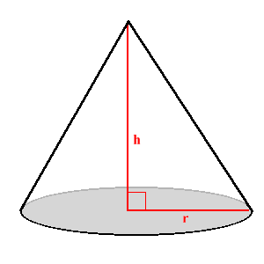
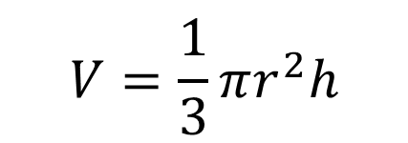

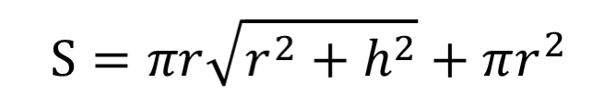
Volume and Surface Area
Volume of Surface Area of a Right Circular Cone
The volume V and surface area S of a right circular cone with base radius r and height h are given by the formulas:

Slide 10
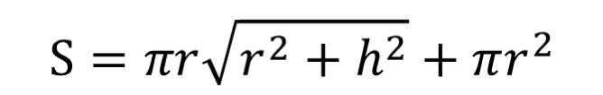
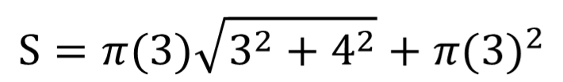
Find the volume and surface area of the cone below.
h = 4 m
V = (1/3)π(3)²(4)
r = 3 m
V = 12π
V = 37.68
m³
S = 15π + 9π
S = 24π
S = 75.36
m²

Slide 11
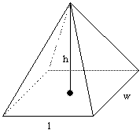
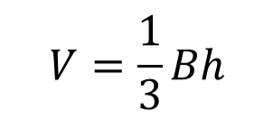
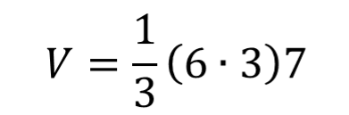
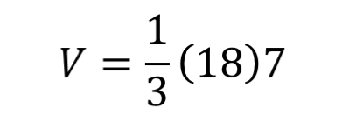

Volume and Surface Area
Volume of a Pyramid
The volume V of a pyramid with height h and base of area B is given by the formula:
Note: B represents the area of the base (l w).
Find the volume of the pyramid (rectangular base) below.
7 cm
3 cm
6 cm
cm³

Slide 12
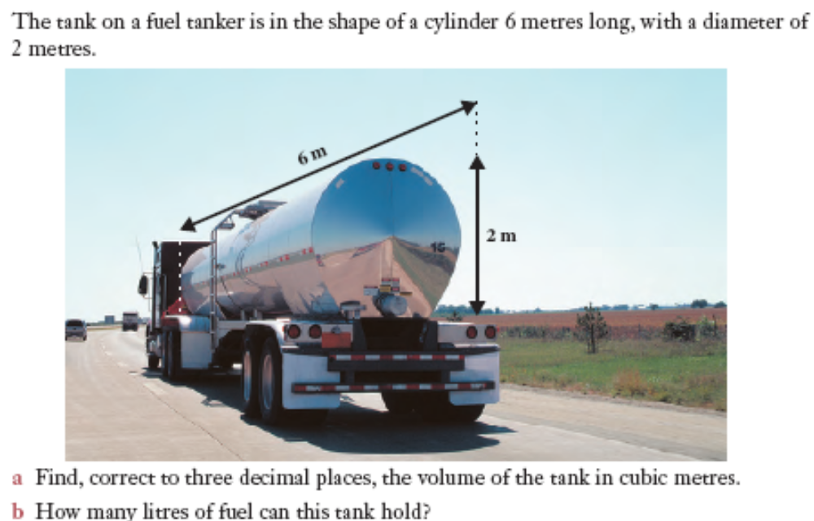

Slide 13
Now complete exercise 11 on pages 37-39 in MAWA Essentials Units 3&4

